Slide 1
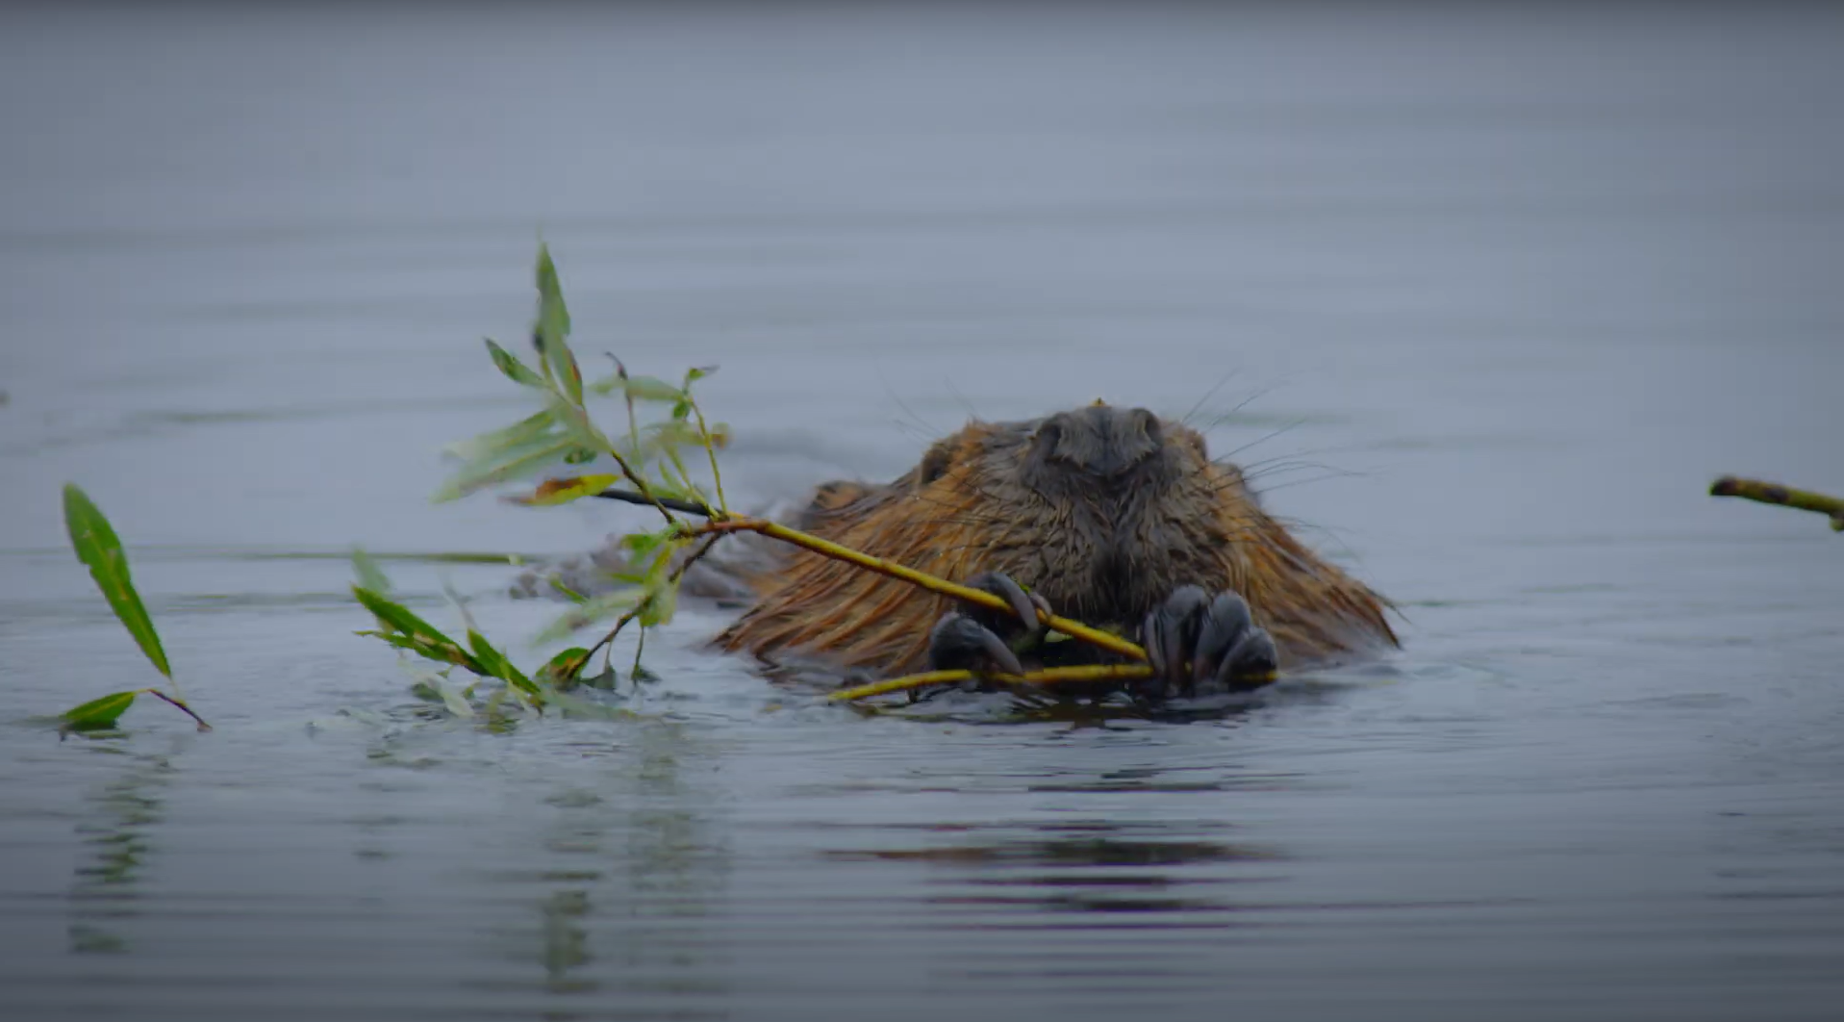

Two Poems on the Charles River
Sensory Poetry About Place
Longfellow House-Washington’s Headquarters National Historic Site
Notes:
SLIDE 1: Introduce the lesson: students will be listening to, reading, and writing their own poetry about special places.

Slide 2

“Poetry allows you to express yourself, to tell your own story about the things you see and what you feel.”
-Yolanda Oliveira
Notes:
SLIDE 2: One of the poets we’ll meet in this lesson is a high school student from Boston named Yolanda Oliveira. Yolanda says that “Poetry allows you to express yourself, to tell your own story about the things you see and what you feel.”

Slide 3
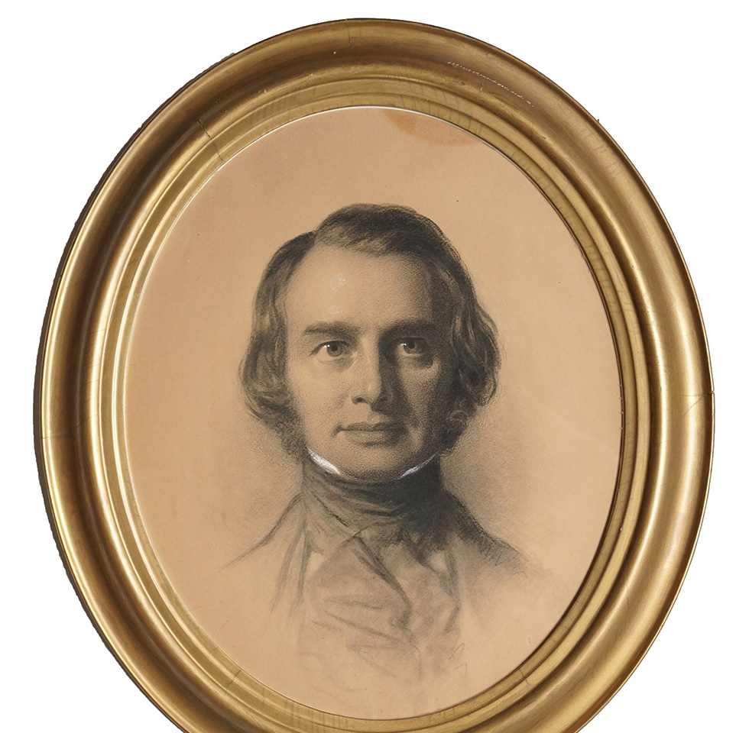
Henry Wadsworth Longfellow (1807-1882)
Notes:
SLIDE 3: The other poet we’ll read today lived in the 1800s. Henry Longfellow (1807-1882) took inspiration from many things – his family, history, his community, travel, literature, and nature. Born in Portland, Maine, Longfellow lived in Cambridge, Massachusetts for much of his adult life.

Slide 4
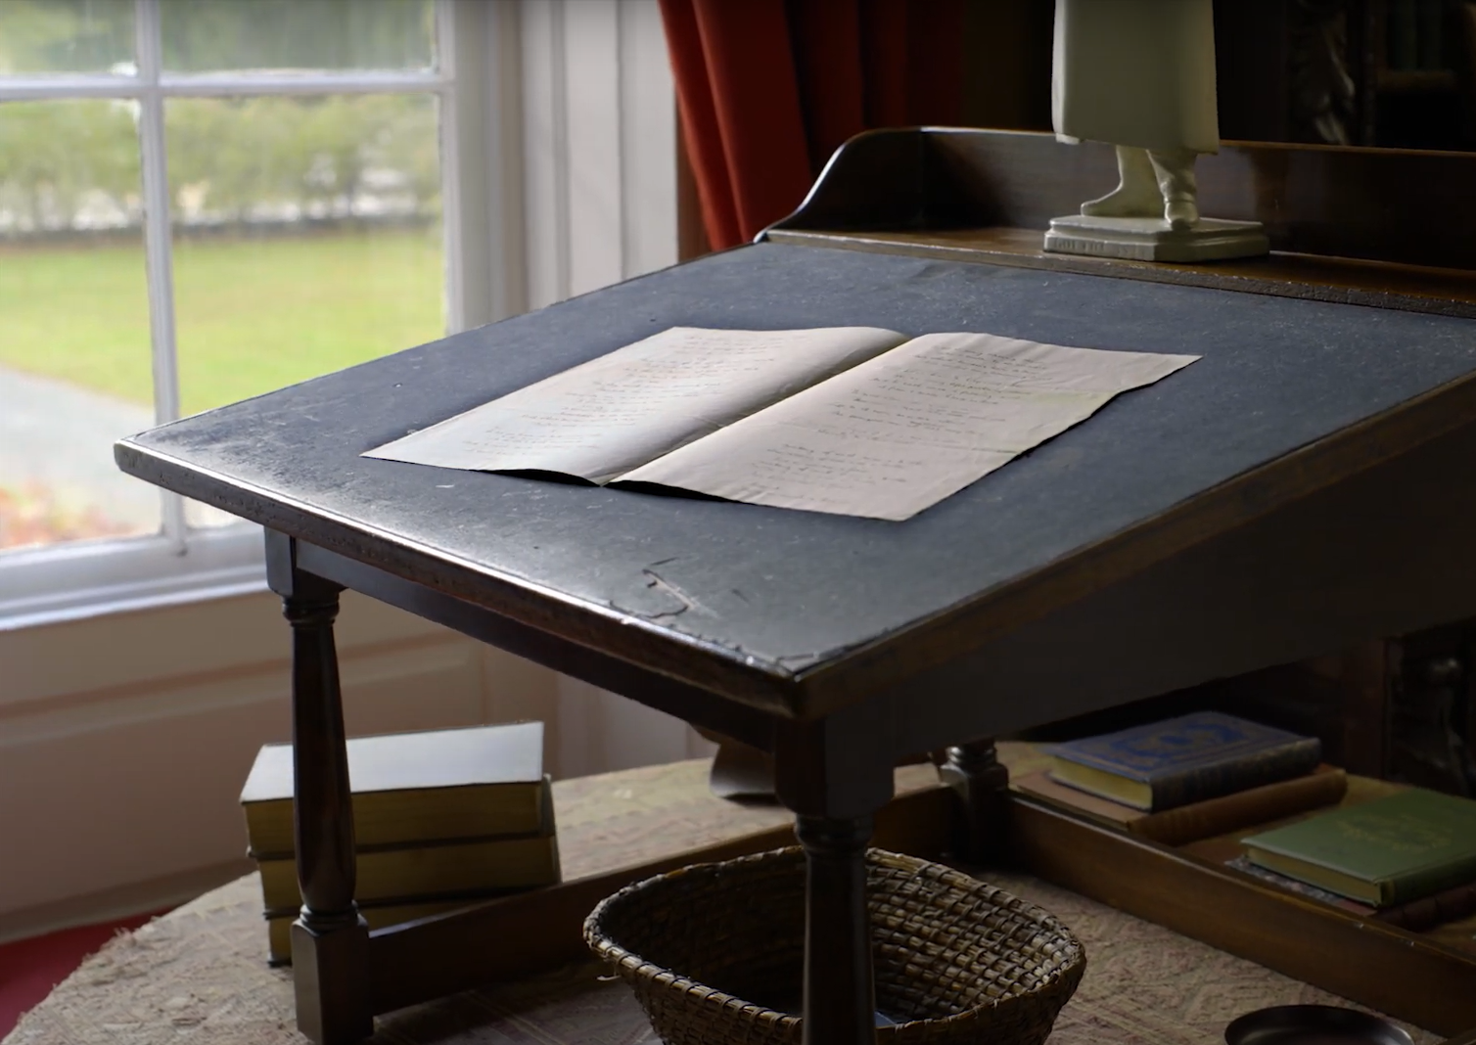
Who are some poets you’ve heard of?
Do you have a favorite poem?
Notes:
SLIDE 4: Ask - Who are some poets you’ve heard of? Does anyone have a favorite poem?

Slide 5
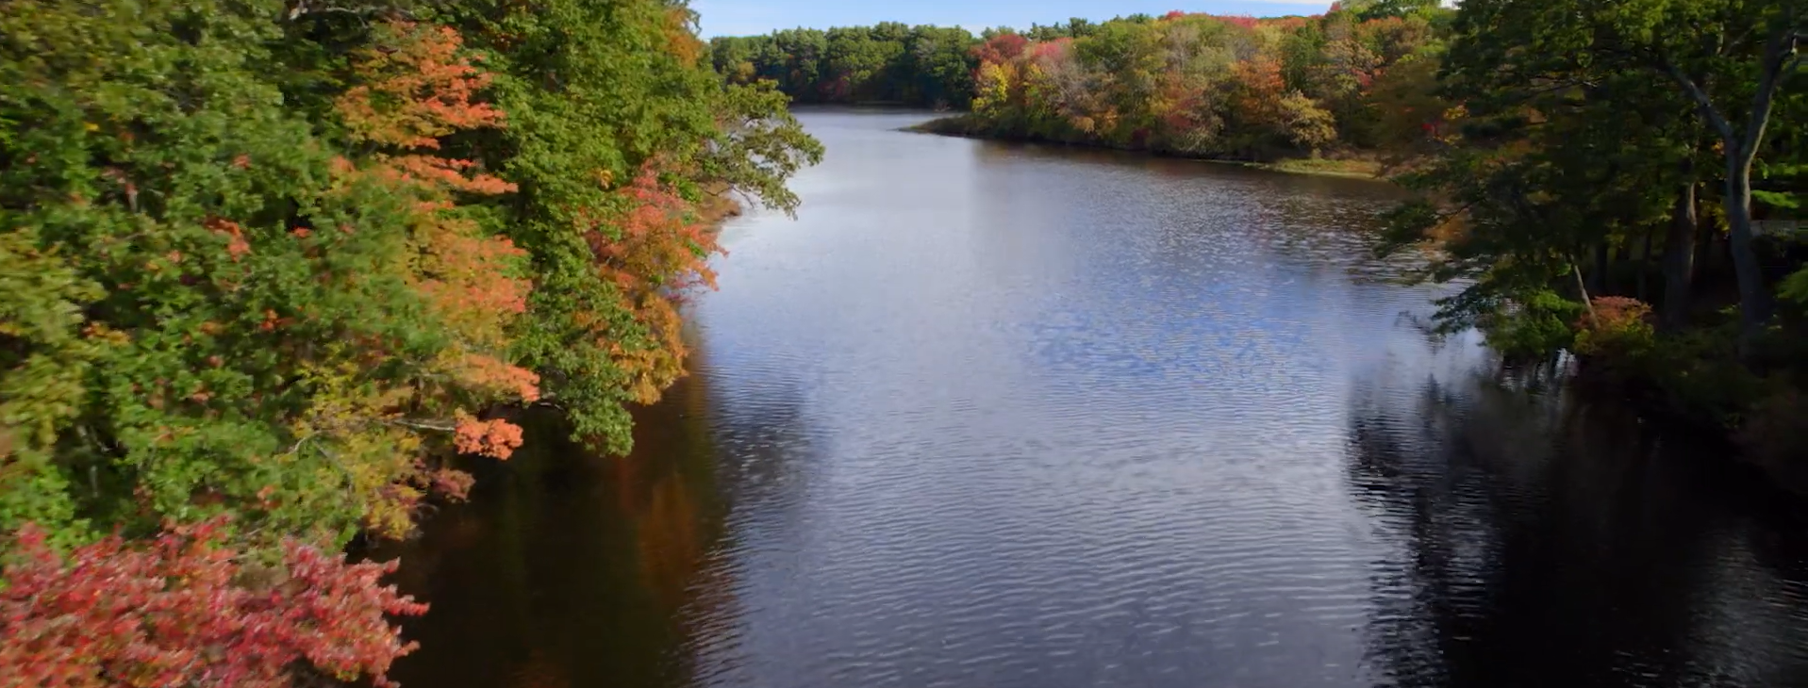
Close your eyes and think about your favorite place.
How does it feel to be there? What does it look, sound, or smell like?
Notes:
SLIDE 5: One of Henry Longfellow’s favorite places was the river near his house – the Charles River. From the window of his study at 105 Brattle Street (now Longfellow House-Washington’s Headquarters National Historic Site), Longfellow loved to look out on the Charles River.
Close your eyes and think about your favorite place. How does it feel to be there? What does it look, sound, or smell like?

Slide 6
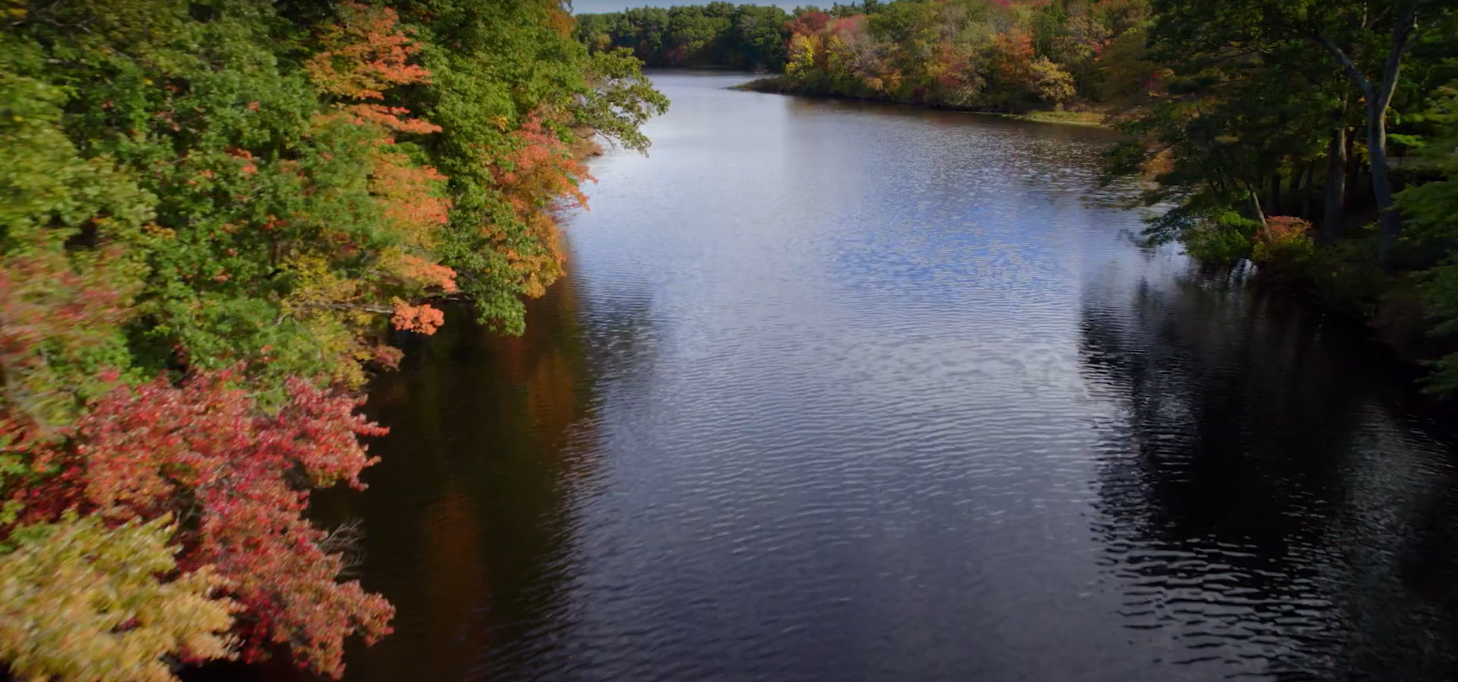
What are adjectives?
Adjectives are words that describe a noun (a thing, person, or place).
Bright
Deep
Blue
Better
Long
Notes:
SLIDE 6: What are adjectives? Adjectives are important words that can help us describe what we see, hear, smell, touch, or taste. They describe a noun (a thing, person, place). Some examples of adjectives in “To the River Charles” include Bright, Deep, Blue, Better, and Long.

Slide 7

What are the Five Senses?
Notes:
SLIDE 7: We can use our five senses to describe places. What are the five senses? (See, hear, smell, touch, taste)

Slide 8

Sight descriptions
A river looks:
Notes:
SLIDE 8: Brainstorm words that describe how a river looks. Use adjectives to describe specific parts of the river. Recommended: create a running class list of brainstormed adjectives. Examples: bright, shiny, sparkly water, green trees, energetic ducks.

Slide 9

Hearing descriptions
A river sounds:
Notes:
SLIDE 9: Brainstorm words that describe how a river sounds. Examples: gurgling, loud, quiet, whispering wind.

Slide 10

Smell descriptions
A river smells:
Notes:
SLIDE 10: Brainstorm words that describe how a river smells. Examples: fresh, stinky, fishy, clean.

Slide 11

Touch descriptions
A river feels:
Notes:
SLIDE 11: Brainstorm words that describe how a river feels. Examples: wet, cool, slimy rocks, strong current

Slide 12

Taste descriptions
A river tastes:
Notes:
SLIDE 12: Brainstorm words that describe how a river tastes. (Students may need to use their imaginations for this one!) Examples: refreshing, clean, muddy.

Slide 13
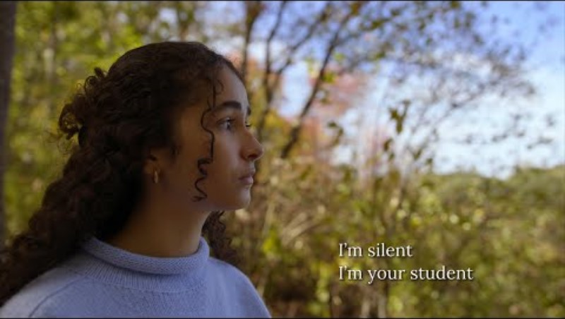
Notes:
SLIDE 13: Show video. Ask students to listen for parts where you can really imagine what the poet is describing. Direct link: https://youtu.be/6N4XUDRdURQ?si=9H8KXtKD2gBNv7cd

Slide 14
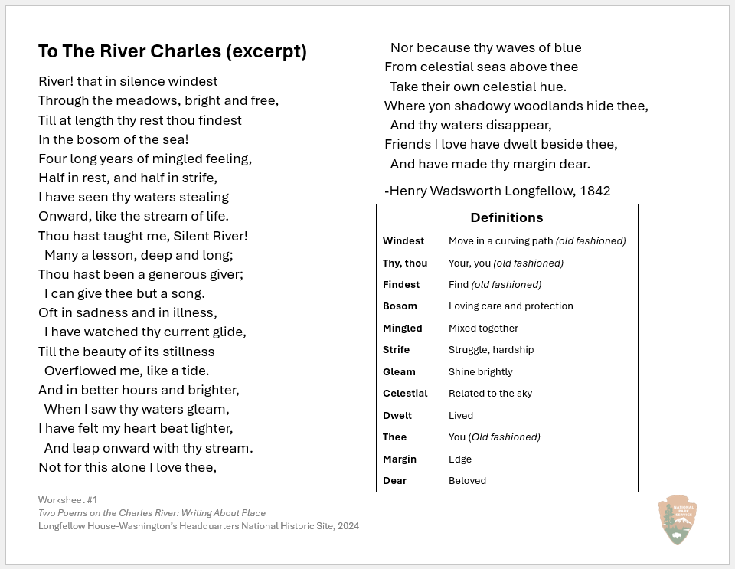
Underline descriptive words.
Circle parts that show the poet’s connection to the place.
Notes:
Hand out poem worksheets
SLIDE 13:
Underline adjectives and other words that describe one of the five senses. How many of the five senses can you find?
Circle parts where the poet is talking about why they feel connected to this place.

Slide 15
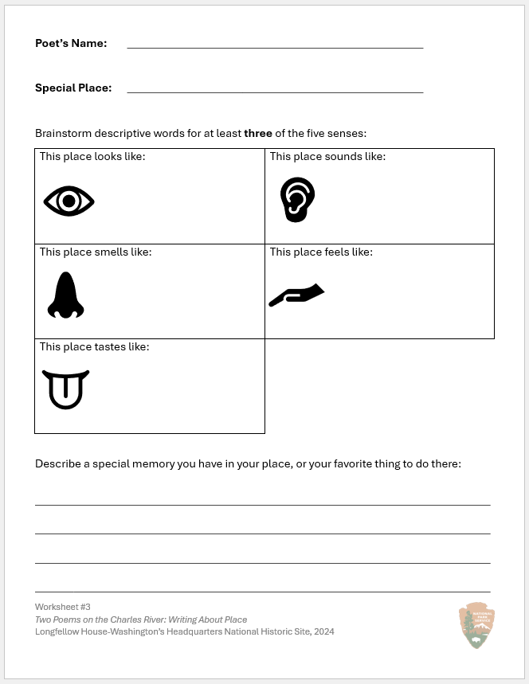
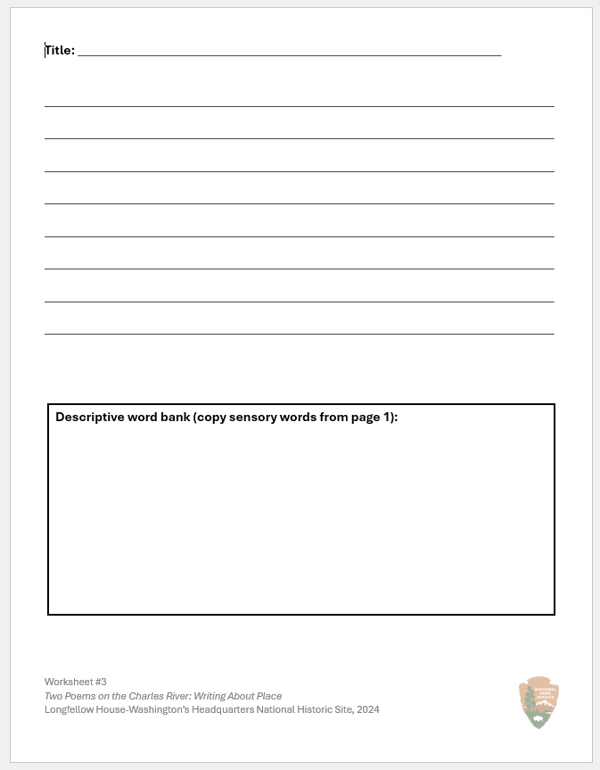
To the Roller Skating Rink
The Roller Skating Rink
Oh rink where I skate,
With your bright neon lights,
Your sour slushies are great,
Your disco ball sparkles just right.
When I won my first race
I felt scared and proud,
The music got quiet,
But my skates clacked out loud.
Bright neon lights, sparkling disco balls
Loud music, clacking skates
Buttery popcorn, lemon cleaner
Scratchy carpet, smooth floor, rough and bumpy walls
Too-hot pizza and sour slushies
Bright, sparkling, loud, clacking, buttery, lemon, scratchy, smooth, rough, bumpy, too-hot, sour
One time I won a race at the roller rink! I felt really proud of how fast I skated. I almost forgot how to stop, which was exciting and scary!
Notes:
SLIDE 15: A lighthearted example poem – use as needed, or create your own.
Instructions:
Think about a place you love, or have favorite memories of. What special place will you write about?
Brainstorm descriptive words for at least three of the five senses. Encourage students to think creatively.
Describe a special memory you have in your place, or your favorite thing to do there.
Write your poem! Include your descriptive words and a mention of your memory. Try writing your poem “to” the special place, like Longfellow and Oliveira did.

Slide 16
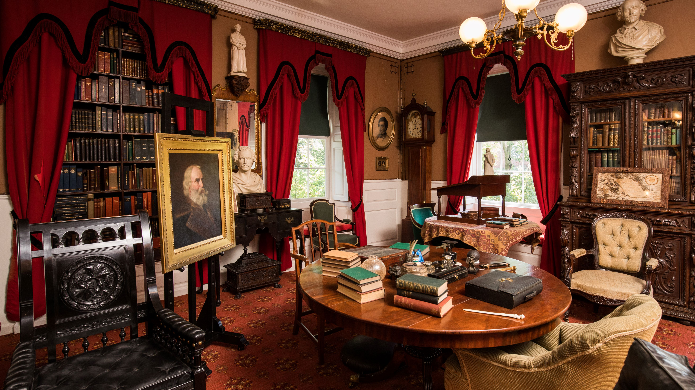
Welcome to the Poetry Reading!
Notes:
Use this slide as an optional backdrop for your class poetry reading.

